Slide 1
Impact of Cognitive Bias on User Interaction Sequences in Visualizations
Emily Wall Kuhu Gupta Arup Arcalgud Andrew Jo
Notes:
Arup
Arup 1-3, 12-21
Emily 4-11, 35-36
Kuhu- 22-26
Andrew 27-34

Slide 2
Intro
Notes:
Arup
How we define bias in this context
Why this topic is significant
What our study hopes to show

Slide 3
Background
Data is everywhere today
Data visualizations are increasingly used to make critical decisions in healthcare, business, government policy, etc.
If bias is brought into these data interactions and data-based decisions, the outcomes could be greatly affected
Notes:
Arup
Data is everywhere
Patient health data, financial data, environmental data, demographic data, etc.
Everyday _______ decisions are mad

Slide 4
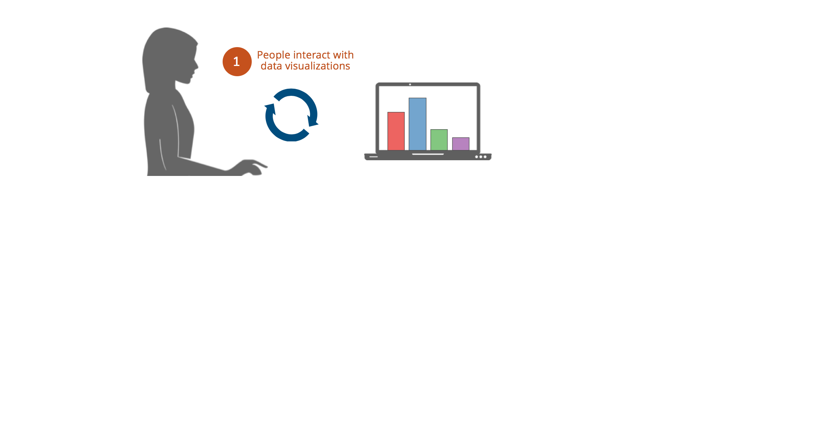
Notes:
EMily
Here’s a graphic to show why focusing on problems of bias in visualization has potentially high value. People interact with data in visualizations by clicking, hovering, and so on.

Slide 5
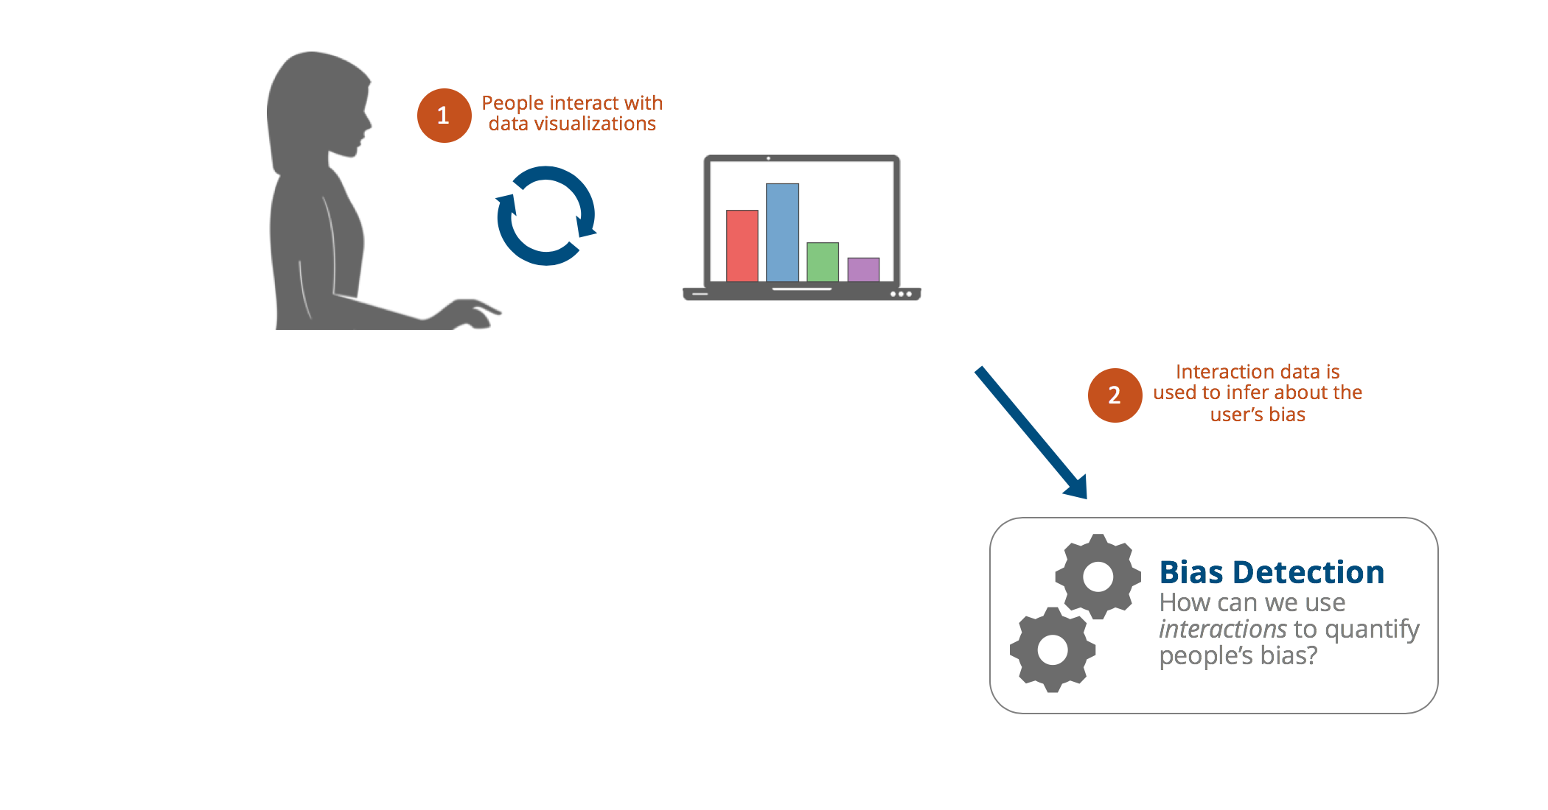
Notes:
Emily
Next we can use those interactions as a rough approximation of the user’s cognitive state roughly detect or characterize aspects of their biases.

Slide 6
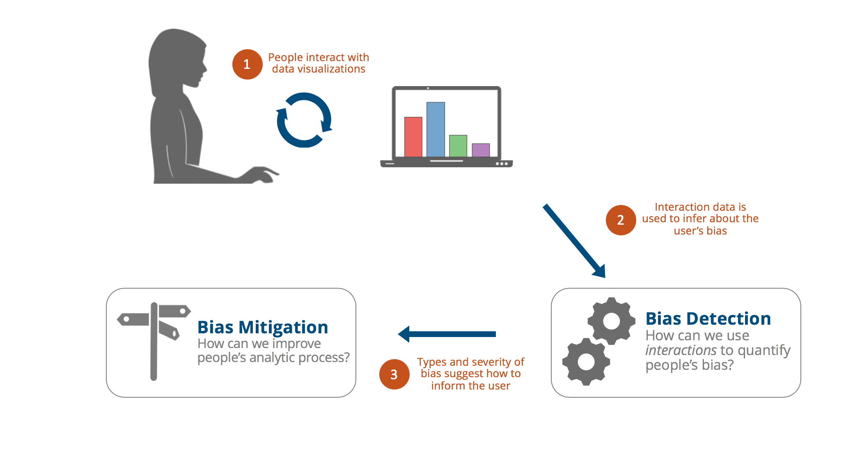
Notes:
Emily
And if we know how people are biased, the types and severity of those biases can suggest ways that we can inform users.

Slide 7
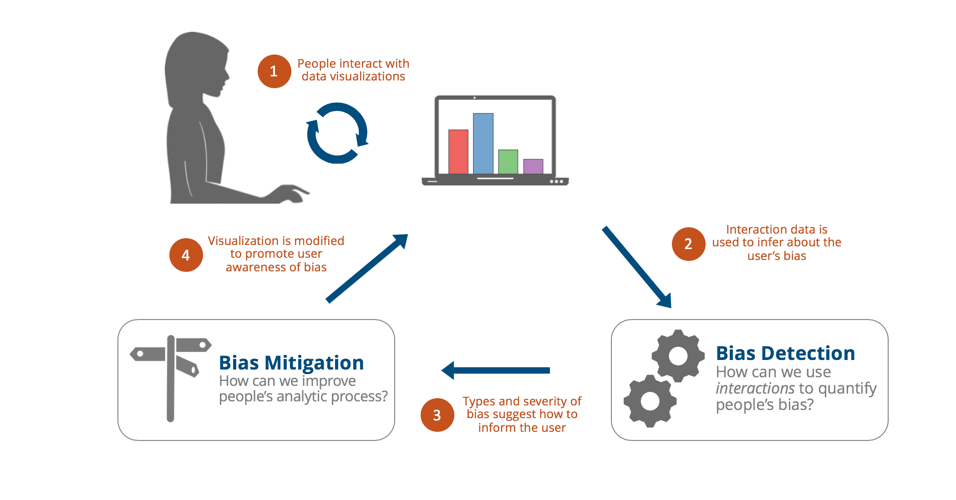
Notes:
EMily
Then we can design interventions that can modify aspects of the interface to make users aware of those biases in real time to help them make better decisions. In this work, we focus on refining bias detection.

Slide 8
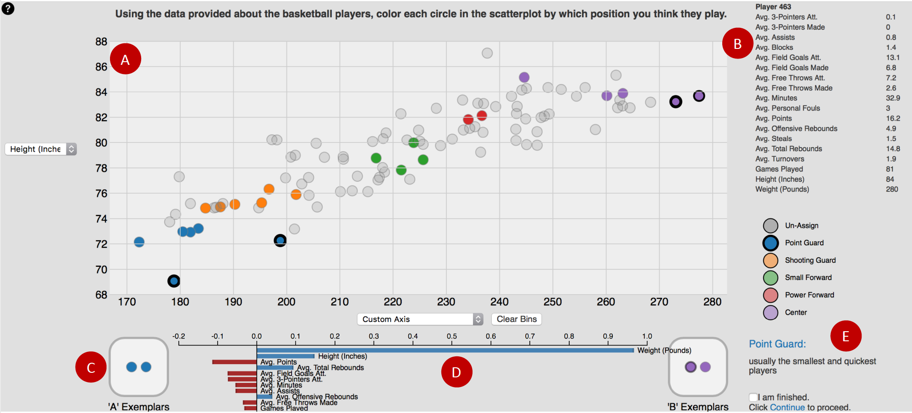
Experiment System: InterAxis
Notes:
Emily
So before we we dig too much into the details of bias detection, let me first show what the system looks like that we are using. We are looking at a dataset of basketball players. (A) is showing a scatterplot where each point is a basketball player. Hoving over those points will show some statistics about that player on the right labeled (B). For the sake of time, I’m going to skip over the other parts for now.

Slide 9
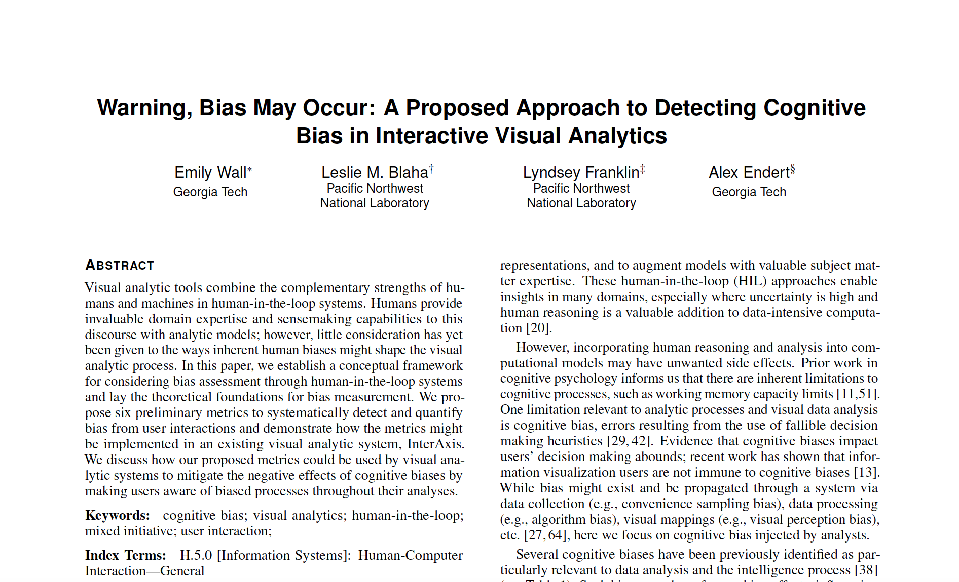
Bias Metrics & Defining a Baseline
Notes:
emily
In a previous paper, we defined a set of computational metrics for characterizing bias based on people’s interactions with a visualization.

Slide 10
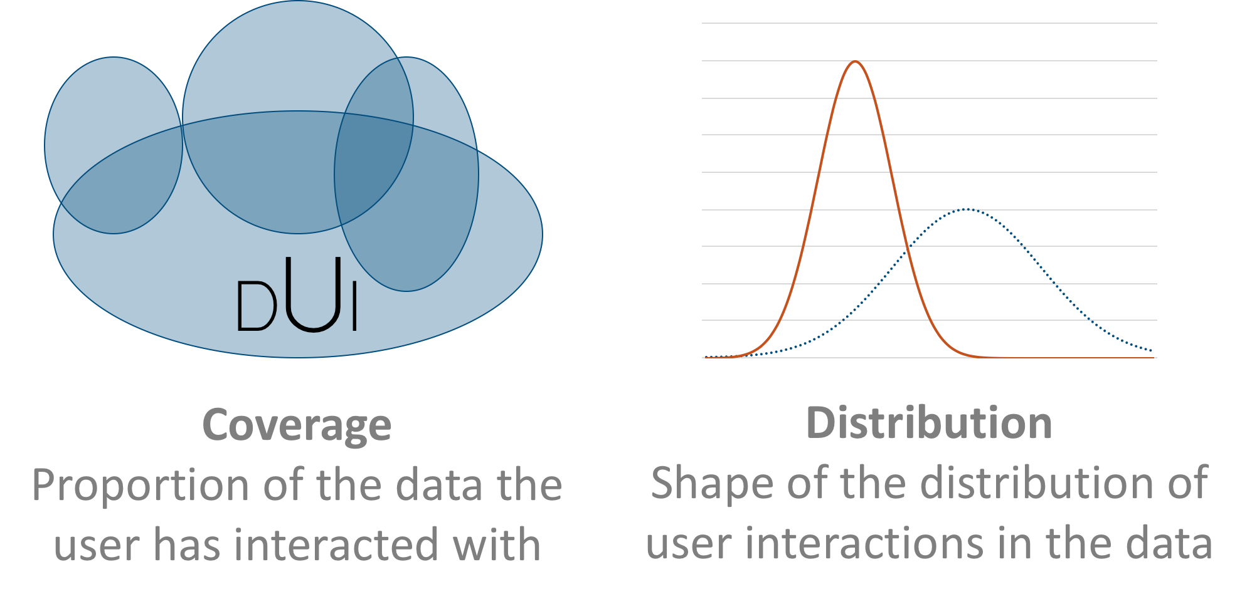
Bias Metrics
Notes:
Emily
So as input, the bias metrics take in the user’s interaction sequences. In the context of the system I just showed, InterAxis, the input includes the sequence of data points that user interacts with as well as the types of those interactions -- so hovers, clicks, drags, and so on are used to compute these metrics.
There are two types of metrics based on “coverage” and “distribution”. For “coverage”, we can compute how much of the data space the user has covered from those interactions. For “distribution”, we can compare the distribution of those interactions to the underlying distributions of the data.

Slide 11
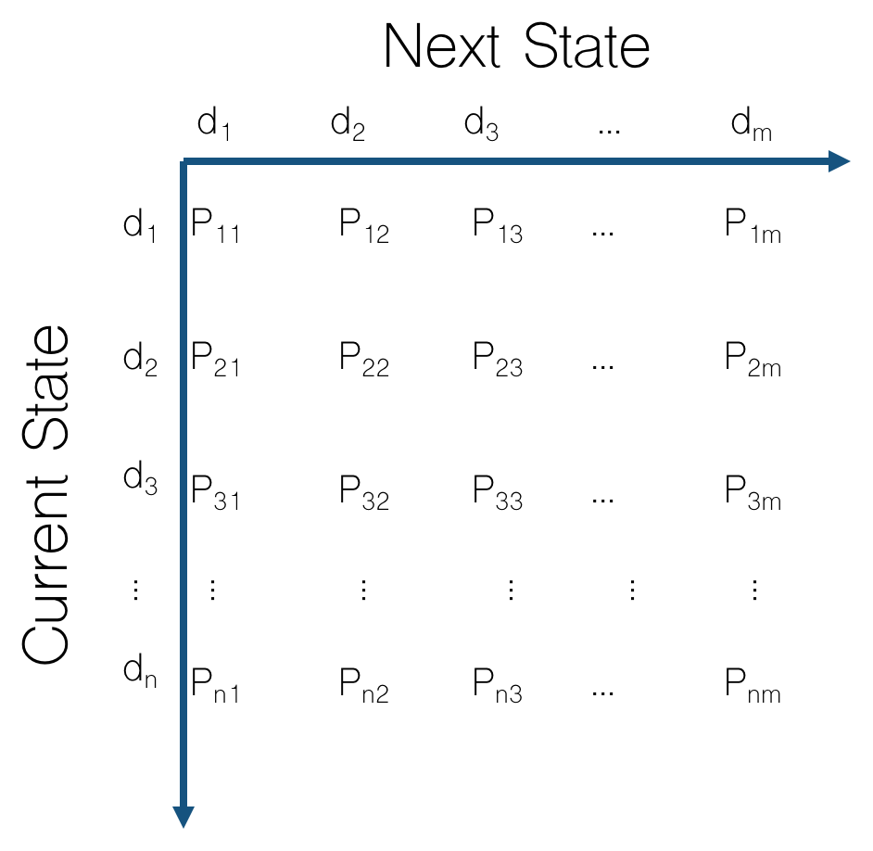
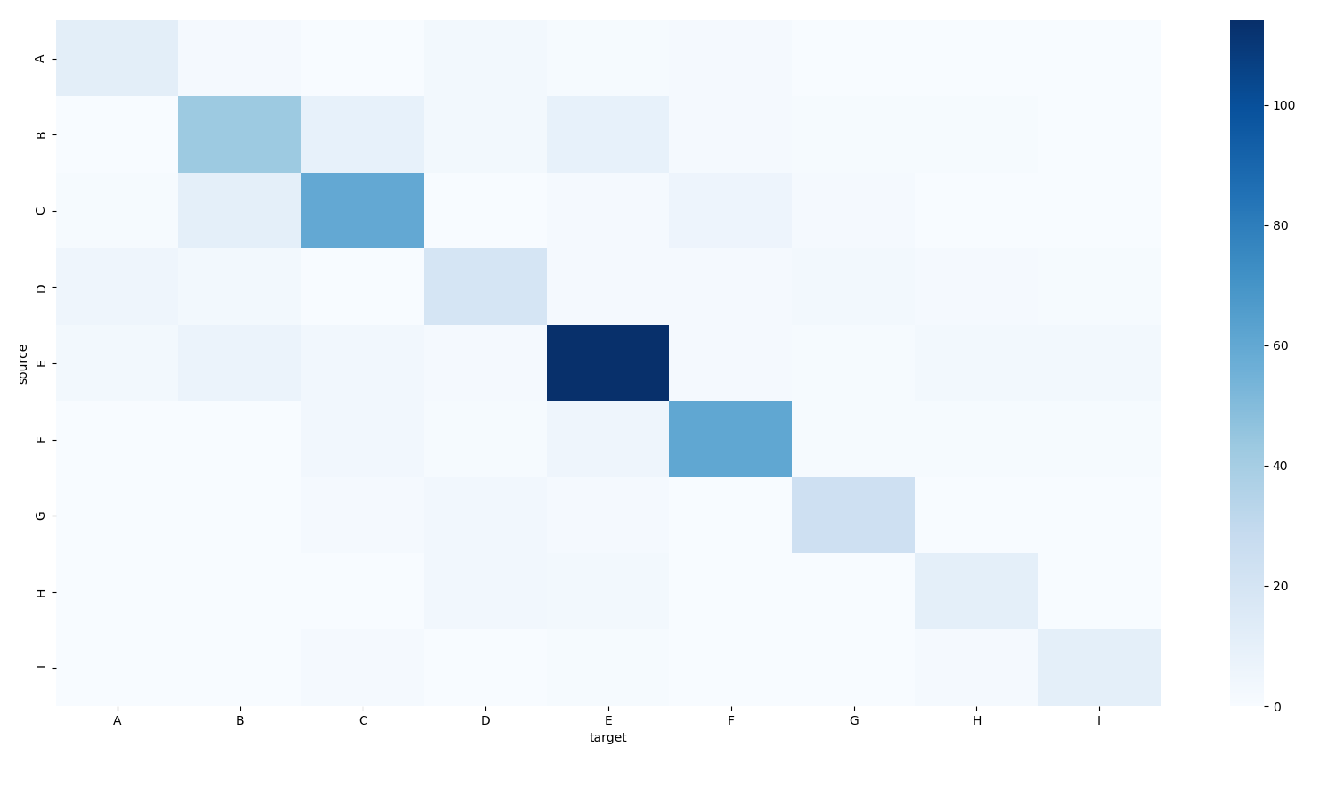
Defining “Unbiased” Behavior
Accuracy of the metrics depends on the accuracy of the baseline
Prior assumption: all interactions are equally likely.
Notes:
Emily
But all of this relies on comparing the user’s interactions to some notion of “unbiased” behavior. We model this using a markov model -- we consider the probability of the user’s next interaction by considering what their current interaction is. We can visualize this as a matrix, where the value in one cell represents the probability of first interacting with the data point represented by that row, and next interacting with the data point represented by that column.
In the initial paper, there was a coarse assumption that all interactions are equally likely. That’s probably not true in most cases.

Slide 12
Research Questions and Hypotheses
Notes:
Arup
That brings us to our research questions and hypotheses.

Slide 13
Goal:
Refine the baseline of unbiased behavior to ultimately improve the accuracy of the metrics for detecting bias.
Notes:
Arup
Our goal in this project was the refine the baseline of unbiased behavior -- to understand how people truly interact with data -- so that we can improve the metrics for detecting bias.

Slide 14
RQ:
How does (anchoring) bias impact the way that people interact with data visualizations?
What is the role of bias in the way individuals interact with bodies of data for decision making? Is there a noticeable difference between people who are subject to different bias conditions?
----
There will
Notes:
Arup
Our research question is: how does bias, specifically anchoring bias, impact how people view and interact with data? We will define anchoring bias in just a bit.

Slide 15

H₀:
People’s unbiased interactions can be modeled roughly based on visual salience.
Certain aspects of the visualization are more likely to draw the viewer’s attention.
People interact according to...
Equal Probabilities
Visual Salience
What is the role of bias in the way individuals interact with bodies of data for decision making? Is there a noticeable difference between people who are subject to different bias conditions?
----
There will
Notes:
Arup
We hypothesize that, rather than equal probabilities of all interactions, people’s interactions can be better modeled roughly based on visual salience. where interactions with certain aspects of a visualization are more likely to draw the user’s attention, regardless of anchoring bias.

Slide 16
Experiment Design
Notes:
Arup
So for the design of the experiment

Slide 17
Analytic Task
Categorize 100 basketball players by their position
Notes:
Arup
We asked people to use InterAxis to explore a dataset of 100 basketball players and categorize them based on the position they play.

Slide 18
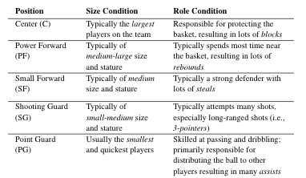
Framing Conditions
Notes:
Arup
There were two conditions, each intended to bias participants in a particular way. We got participants to anchor on specific attributes of the data by modifying the descriptions we gave them of the basketball positions.

Slide 19
Framing Conditions
Notes:
Arup
For participants in the size condition, we gave them descriptions of player positions based on the Height and Weight of players.

Slide 20
Framing Conditions
Notes:
Arup
For participants in the role condition, we gave them descriptions of player positions based on their role on the court, so based on stats like the number of blocks or assist, for example.

Slide 21
Participants & Procedure
13 participants total
7 Participants in the Size condition
6 Participants in the Role condition
Notes:
We had a total of 13 participants complete the study, 7 in the size condition and 6 in the role condition

Slide 22
Data Analysis
Notes:
Next we analyzed the data to try to derive a better set of probabilities to model users’ actual interaction sequences.

Slide 23
Preprocessing
Filtered out hovers and drags < 100 ms (accidental interactions)
Notes:
Before trying to derive new probability matrices, we first filtered out some interactions. Hovers and drags less than 100 ms were likely accidental interactions, while the user passed from one intentional point to the next; so we removed those.

Slide 24
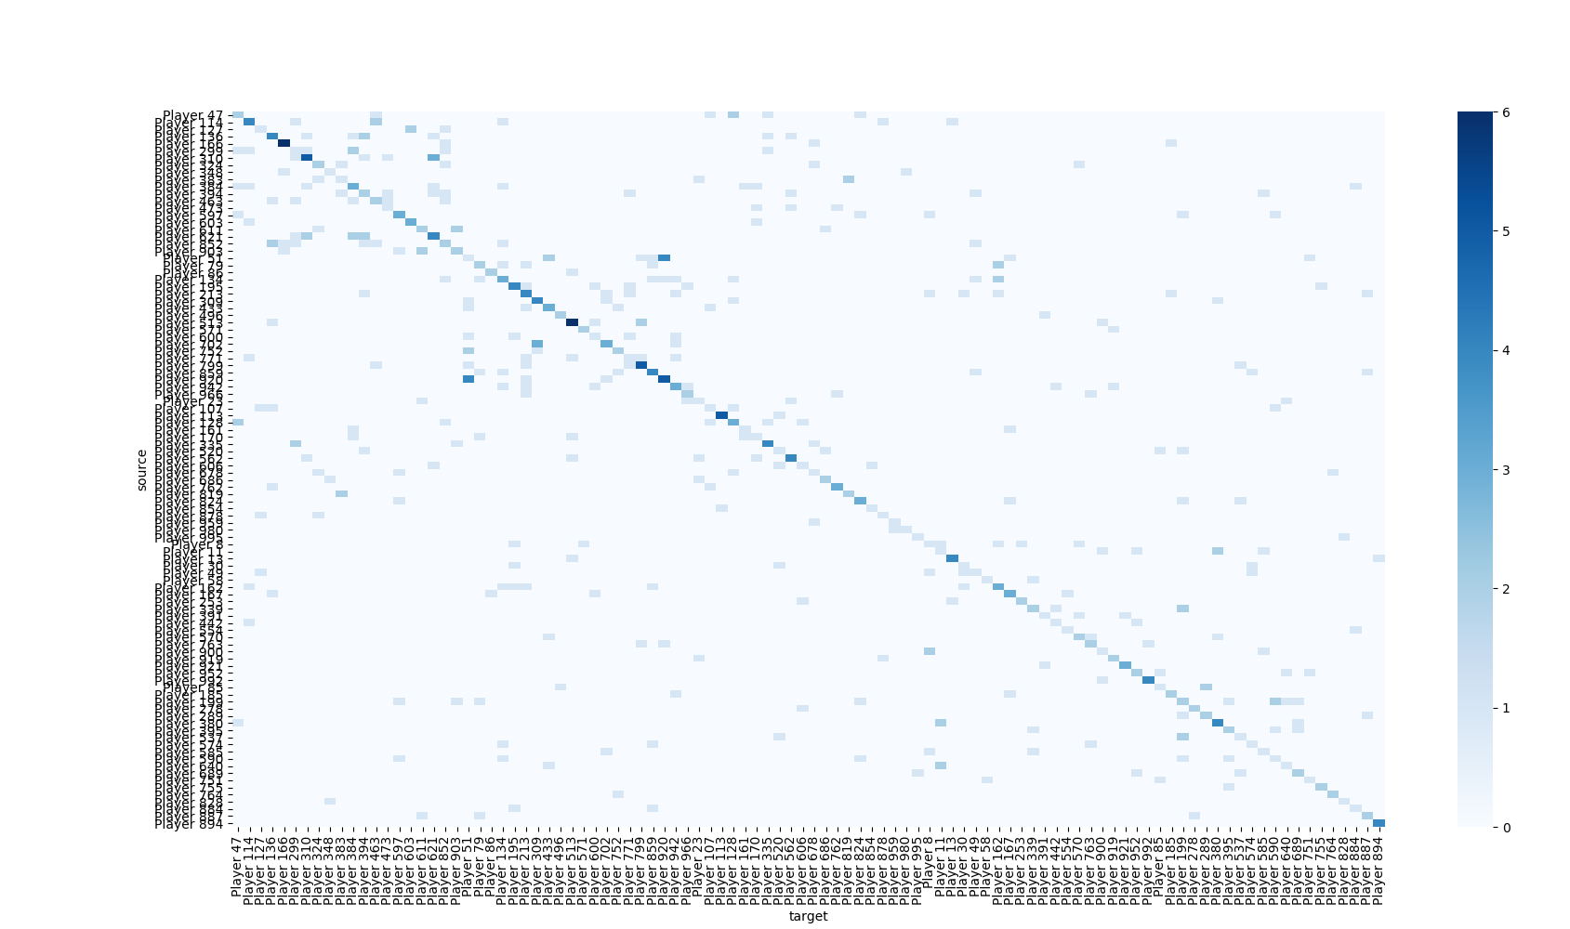
Next Interaction
Point Guard
Power Forward
Shooting Guard
Small Forward
Center
Center
Point Guard
Current Interaction
Power Forward
Shooting Guard
Small Forward
Notes:
Next we wanted to get a sense of the probabilities of interaction sequences between all of the basketball players. Here’s a heatmap that shows the interaction probabilities for one participant in the Role condition. For a given row, that’s the player the user has just interacted with. We predict the next interaction along the horizontal axis. So here we see a strong trend along the diagonal. People are very likely to interact with the same data point multiple times in a row.
We also sorted the players based on position. The highlighted red squares show that there is a slight trend or increased probability of interacting with players of the same position two subsequent times.

Slide 25
All interactions are not created equally
Hovers: [0, 1] scaled by duration
Drags: [1, 2] scaled by duration
Clicks: 3
Notes:
The first type of matrix we created weighted all interactions equally, though. So our next phase was to weight interactions by type, so that the more important or intentional interactions in the system were weighted more highly. Hovers were weighted between 0 and 1 depending on the duration of the interaction, drags between 1 and 2, and clicks were given a weight of 3.

Slide 26
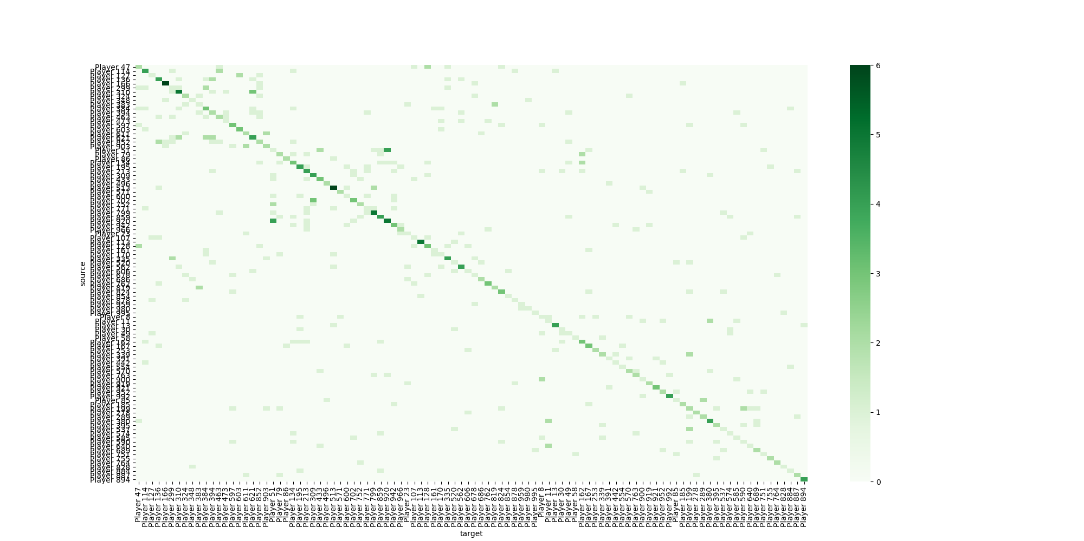
Notes:
Here’s the same participant’s interaction matrix, but this time weighted by interaction type. We didn’t see much change here, so we shifted our attention to other aspects of data analysis.

Slide 27
Equivalence Classes
Notes:
Next we wanted to get some sense of how people interact with data points based on their relative proximity on the screen. Because users have the ability to change the axes and that changes where a data point is visibly positioned on the screen, we created equivalence classes by dividing the axis into quadrants.

Slide 28
Equivalence Classes
A
B
C
D
Notes:
We labeled them left-to-right and top-to-bottom as A, B, C, D. Then we looked at how often people would interact with a data point “nearby” or in the same quadrant. This led to a new probability matrix.

Slide 29
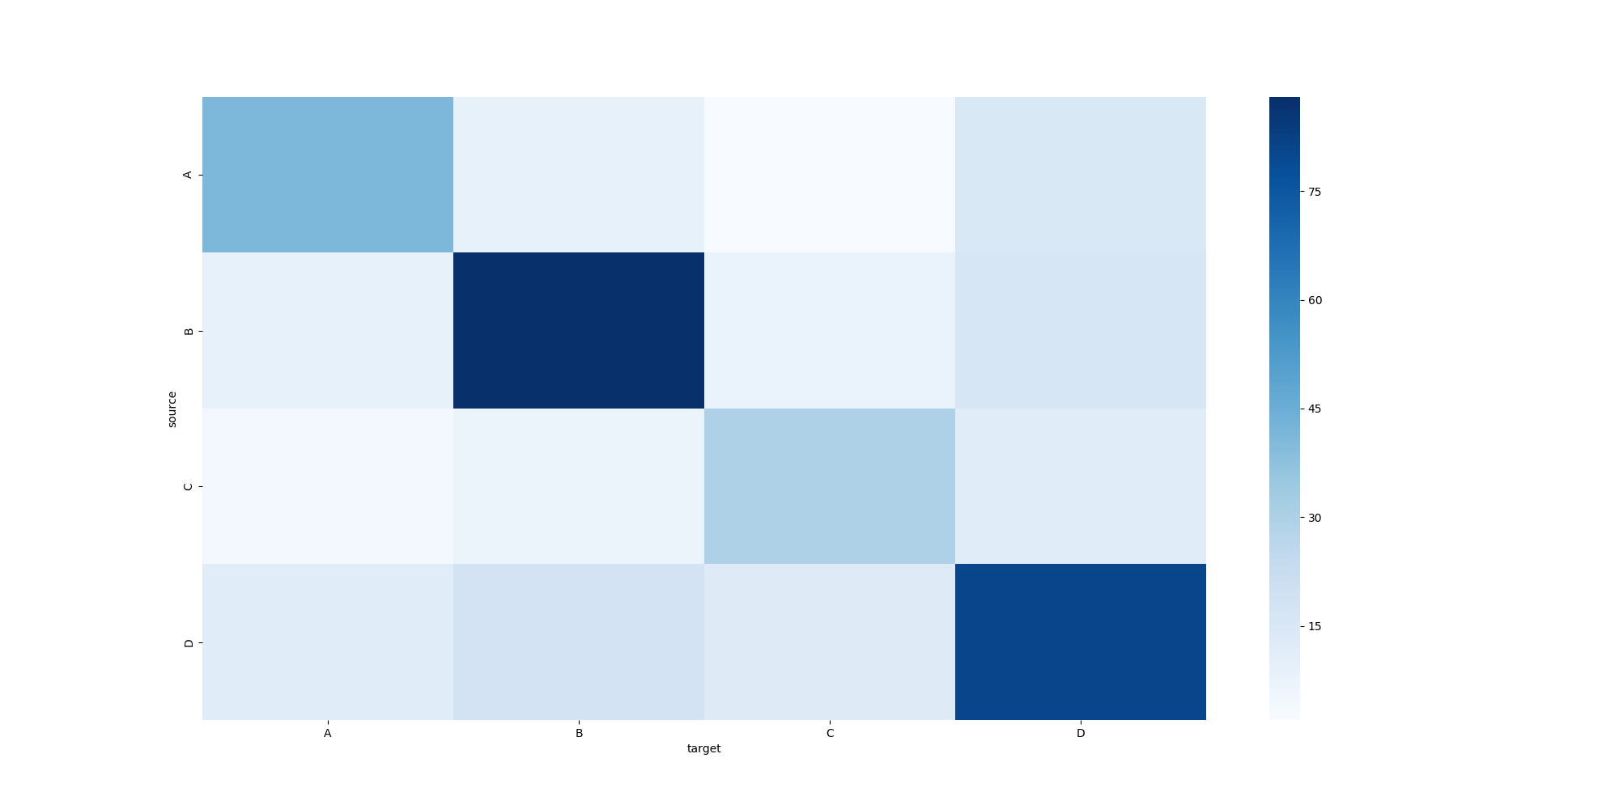
Notes:
We see a similar trend -- people have a strong tendency to interact with a data point in the same quadrant as we see by the strong colors on the diagonal.

Slide 30
Equivalence Classes
A
B
C
D
E
F
G
H
I
Notes:
We did the same thing by breaking up the plot into a 3x3 grid to see if that revealed any new patterns.

Slide 31
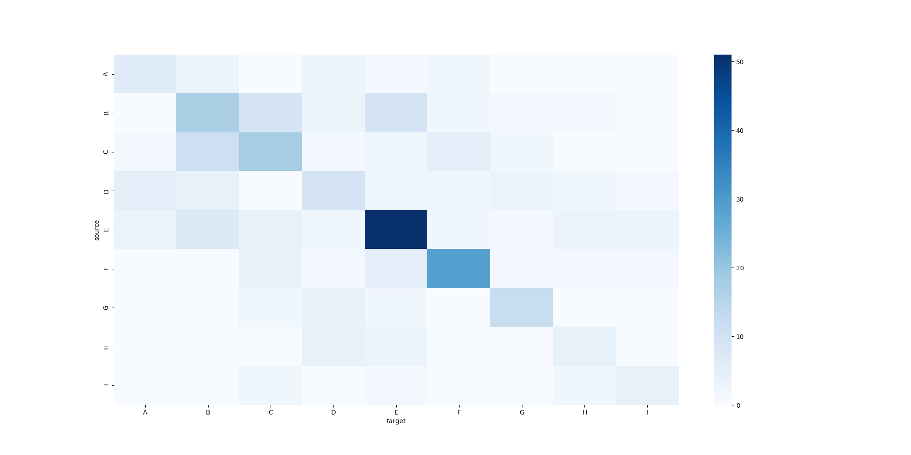
Notes:
This was the result.

Slide 32
Equivalence Classes
A
B
C
D
E
F
G
H
I
J
K
L
M
N
O
P
Notes:
And again we did the same thing for a 4x4 grid.

Slide 33
Notes:
And here’s the result of that.

Slide 34
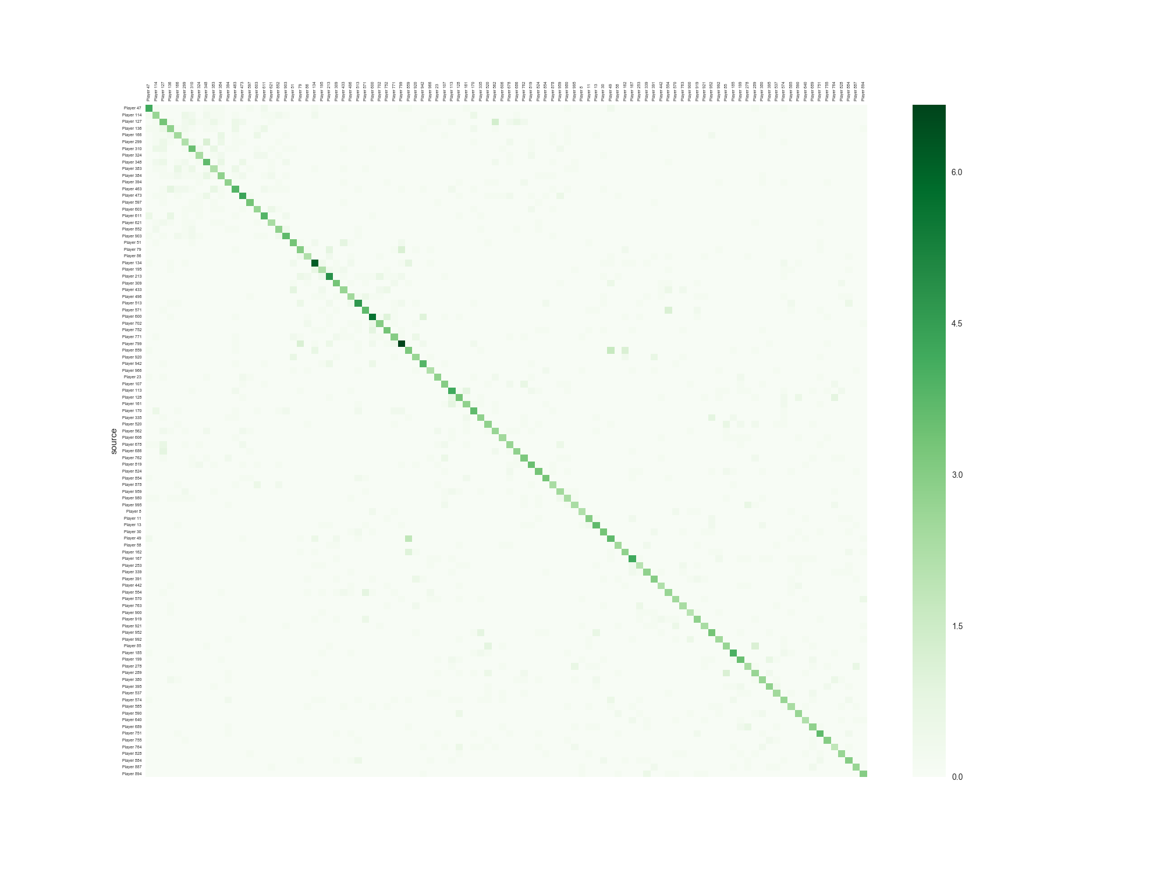
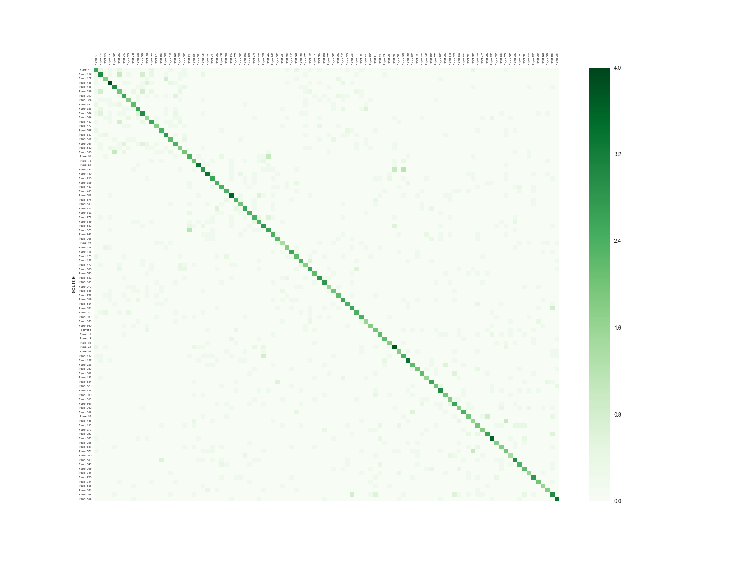
Comparing Conditions
Aggregate - Size
Aggregate - Role
Notes:
If you recall, we had two different conditions in the study, intended to anchor participants on different attributes of the data. Our hypothesis was that people would interact with the data differently across those two conditions, but that there would be some similarities which we could use to inform a better baseline of “unbiased” behavior.
Here we see two matrices representing the average of the people in the Size framing condition on the left and the Role framing condition on the right. We see a similar trend that people tend to interact with the same data point in multiple subsequent interactions, regardless of the condition that people are in.

Slide 35
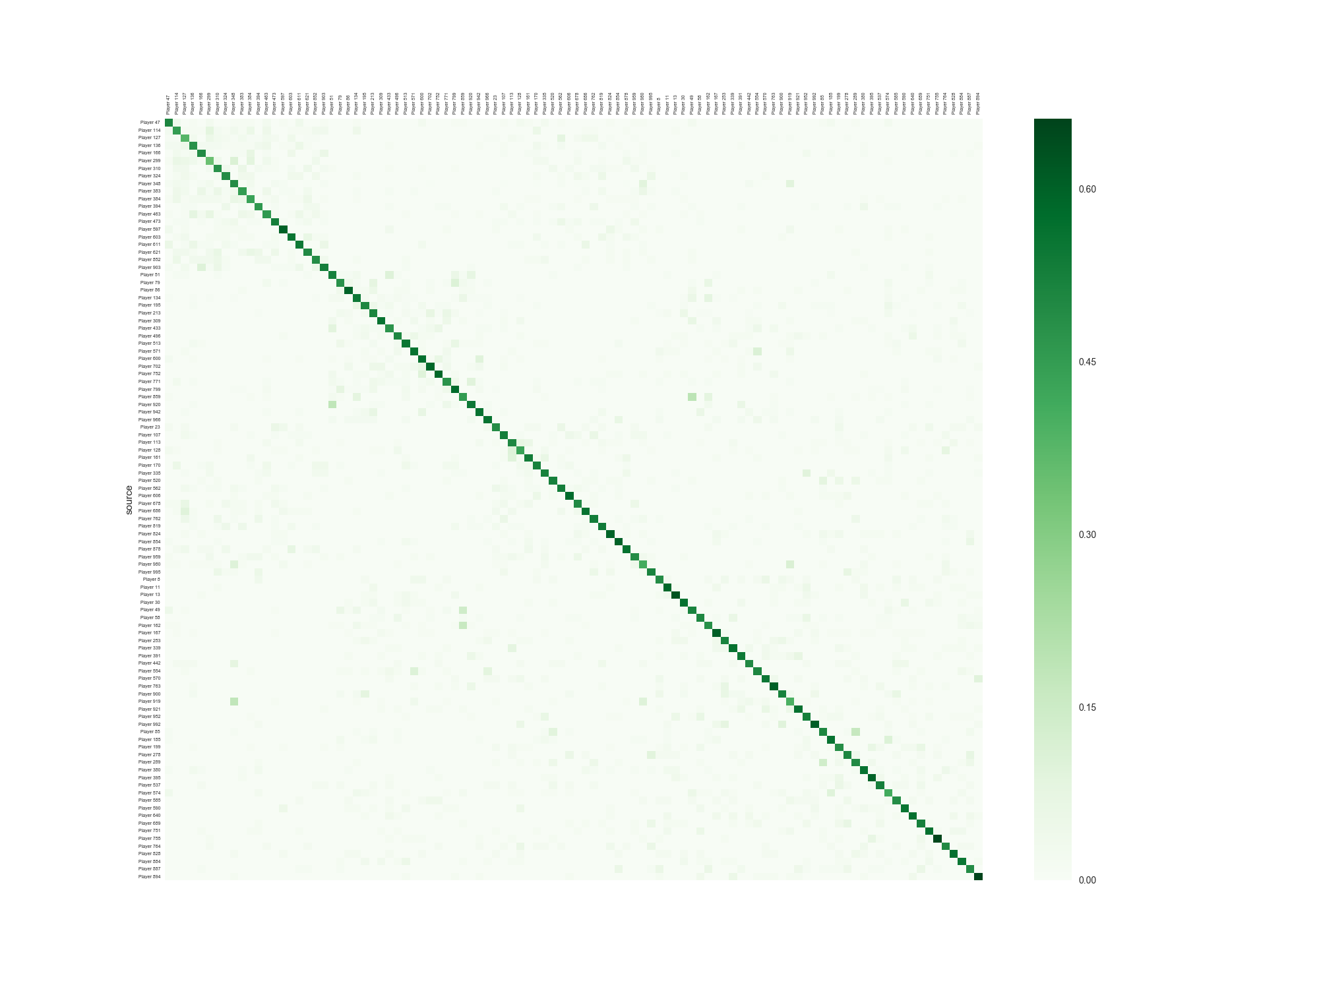
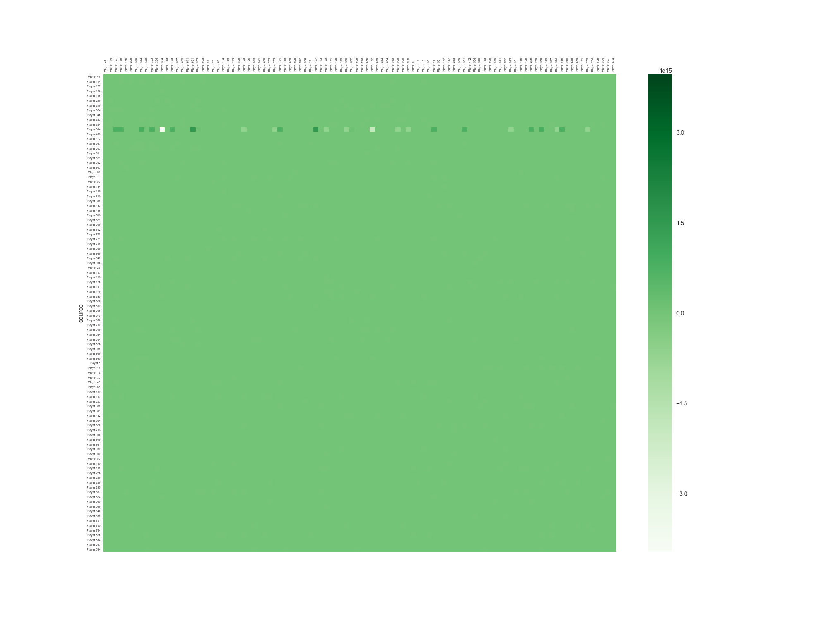
Comparing Conditions - continued
Normalize
Diff
Notes:
We tried to compare the two conditions by normalizing to see the likelihood that the user would interact across all data points. This retains the Markov property that all outgoing edges from a state sums to a probability of 1.
Next, we tried to comparing the different matrices to see if there were any meaningful differences, and saw that except for certain players with interesting statistics that may have confused the participants, there were not many differences regardless of the conditions.

Slide 36
Conclusion
Equal probabilities across all interactions are unlikely to occur, regardless of people’s biases.
Results of our experiment suggest that interactions with data points that are visually closer by should be weighted more highly.
Future work includes analysis of other aspects of visual salience (e.g., color saturation, clusters, outliers, etc.)
Notes:
So in conclusion, equal probabilities across all interactions are unlikely to occur, regardless of how people are biased.
The results of our experiment indicate that interactions with nearby data points are more likely than far away data points. This ultimately helps us to improve the ability of these metrics for detecting bias by having a better idea of what unbiased behavior looks like.
At this stage in our project, data analysis is currently incomplete. In future work, we would like to analyze other aspects of visual salience, including things like color saturation, clusters, outliers, and so on.

Slide 37
Distribution of Work
Andrew: data analysis scripts
Arup: writing & presentation
Emily: system & experiment modifications
Kuhu: data analysis scripts
Notes:
So with that, we’re happy to take any questions you may have.

